Slide 1

Capstone project
- By Lakshmi Sathiraju

Slide 2
Capstone Project – Rent a House
Business Problem:
Mr. John is re-locating to Bangalore, India along with his family. He is looking for a suitable accommodation for rent. He has 4 preferred locations in Bangalore, which are:
Yelahanka.
White Field.
Banashankari.
Hebbal.
He is willing to rent a house in any of these 4 locations. Provided, all the below conditions should be satisfied.
As he is a Foodie, he is looking for nice Restaurants.
He needs a departmental Stores or a Super s.
A Metro/Bus/Train station.
He needs a Park in his neighbourhood, for his relaxation.
He is very much interested in workouts, and needs a full equipped Gym

Slide 3
Capstone Project – Rent a House
Data Source:
This project will utilize data from Foursquare . Foursquare is a technology company that built a massive dataset of location data. What is interesting about Foursquare is that they were very smart about building their dataset. They actually crowd-sourced their data and had people use their app to build their dataset and add venues and complete any missing information they had in their dataset. Currently its location data is the most comprehensive out there, and quite accurate that it powers location data for many popular services like Apple Maps, Uber, Snapchat, Twitter and many others, and is currently being used by over 100,000 developers, and this number is only growing. The data returned from Foursquare API includes many information about restaurants including latitude, longitude, distance from search point, city, province, complete address, business category etc.

Slide 4
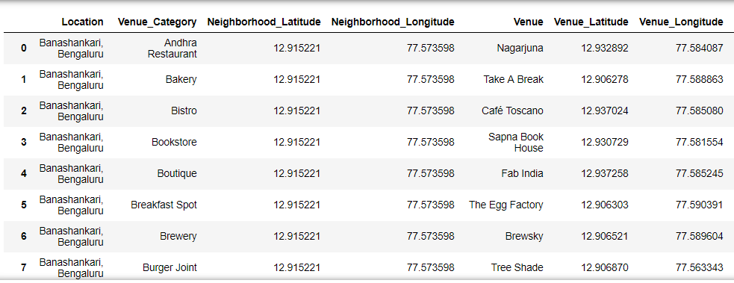
Capstone Project – Rent a House
A Glimpse of Data from Foursquare API:

Slide 5
Capstone Project – Rent a House
Approach/Methodology:
Get Data from Foursquare API, to get the neighbourhoods of each preferred location.
Use plotting libraries to plot each neighbourhood in the map, depicting the spread of preferences in his desired locations.
Based on the preferences of Mr.John, I’ll check if all the conditions are satisfied for his renting.
The best ranked location will be the one which has all the conditions met.
This top location will be suggested for Mr. John for consideration.

Slide 6
Capstone Project – Rent a House
Tools and Capabilities of Python and Data Science
Foursquare API – Location Based Service.
Folium – Leaflet Maps.
Pandas – Data Manipulation and Analysis.
Numpy – Scientific Computing and Mathematics.
Matplotlib – Plotting Library.
Algorithms – To arrive at the right conclusion.

Slide 7
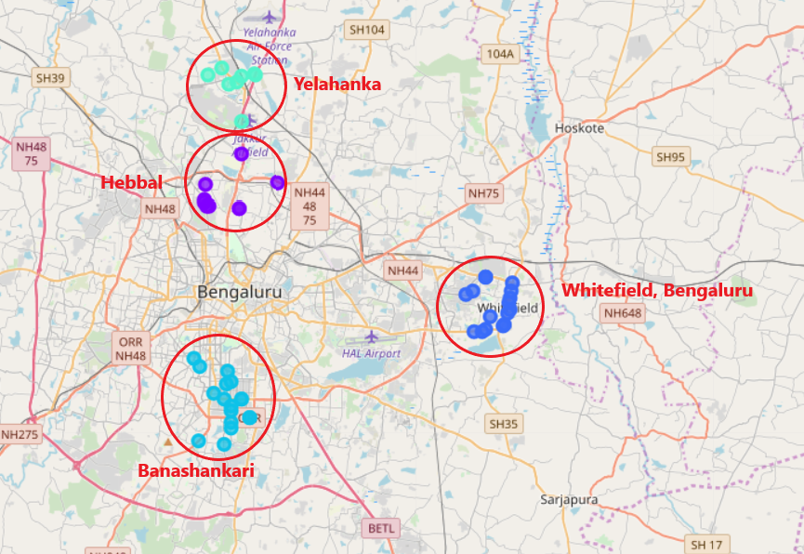
Capstone Project – Rent a House
How to Suggest the best location to rent out ?
Get the Latitudes and Longitudes of preferred locations.
Get the neighbourhoods and Venues of these locations.
Filter out any unwanted Venue, which the user is not looking for.
Plot them on a Map for Visualization.
Make sure that all the preferences of the user has satisfied.
Suggest the best Location to Rent !!

Slide 8
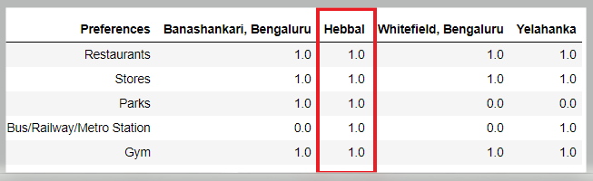
Capstone Project – Rent a House
Conclusions:
→ From the map and Venues returned by Foursquare API, we can conclude that renting a House in “Hebbal” will be the best option, as it has all the preferences, which user is looking for !!
Result:
The logic and approach was able to arrive at best location which can be Rented by the user.

